Slide 1
Sources of information
Books
Encyclopedias
Websites
Online encyclopedias
Film/video

Slide 2
Referencing your resources
As you gather your information THINK about exactly what kind of resource it is.
Refer to pages ii and iii of the blue book.
2. Decide which tool you will use to reference your sources.
Blue Book?
SLASA?
Through Microsoft Word

Slide 3
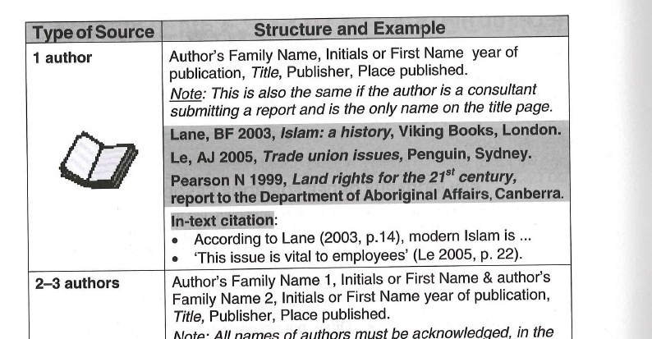
Blue Book

Slide 4
Email from
Mrs Sharp
Making a new folder for your inbox

Slide 5
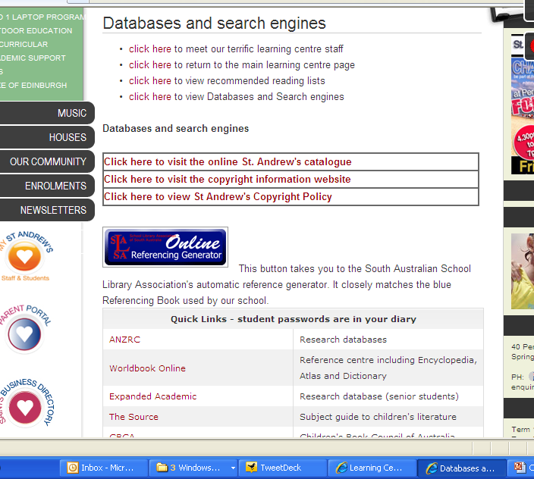
SLASA

Slide 6
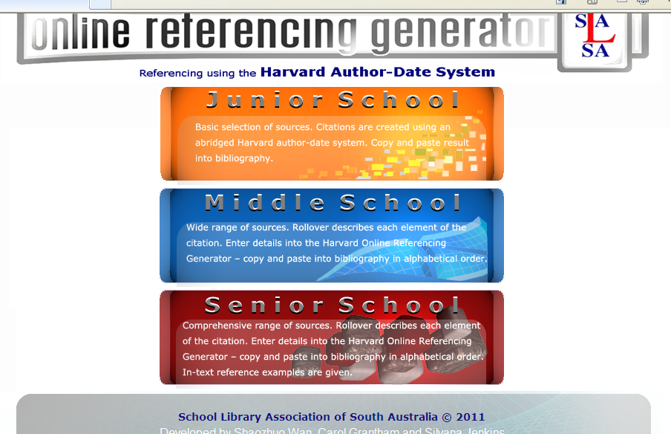

Slide 7
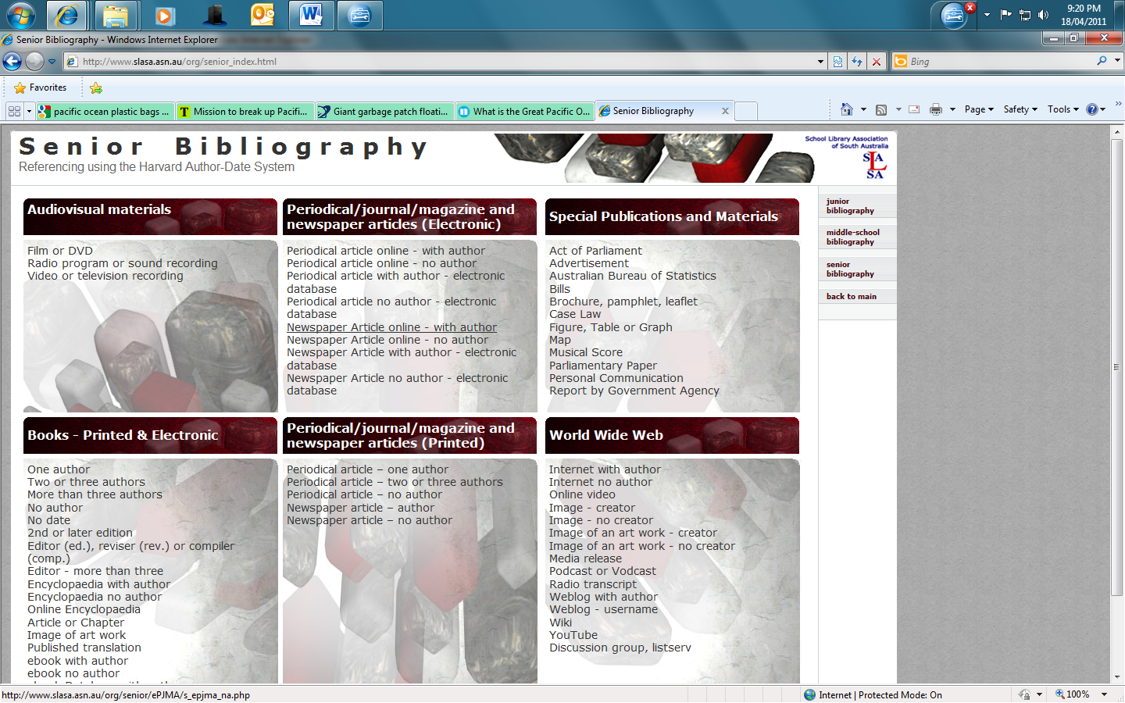

Slide 8
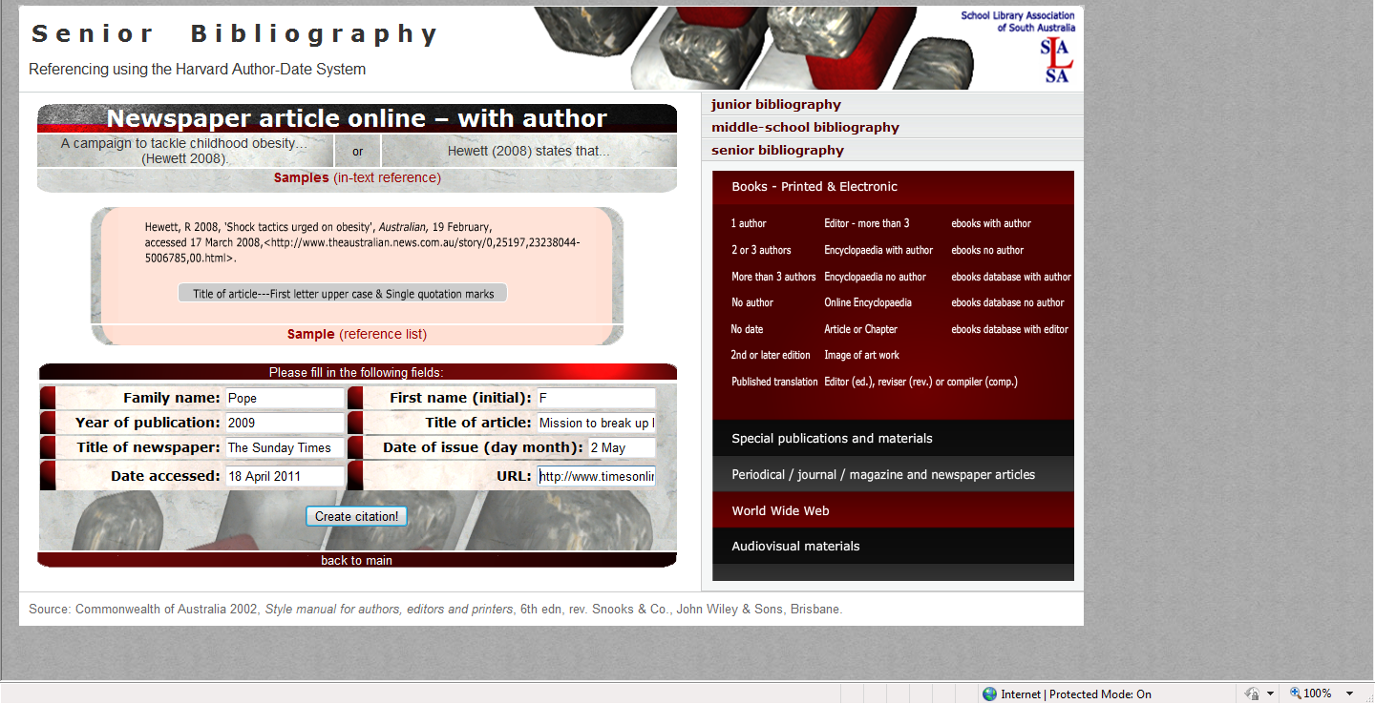

Slide 9
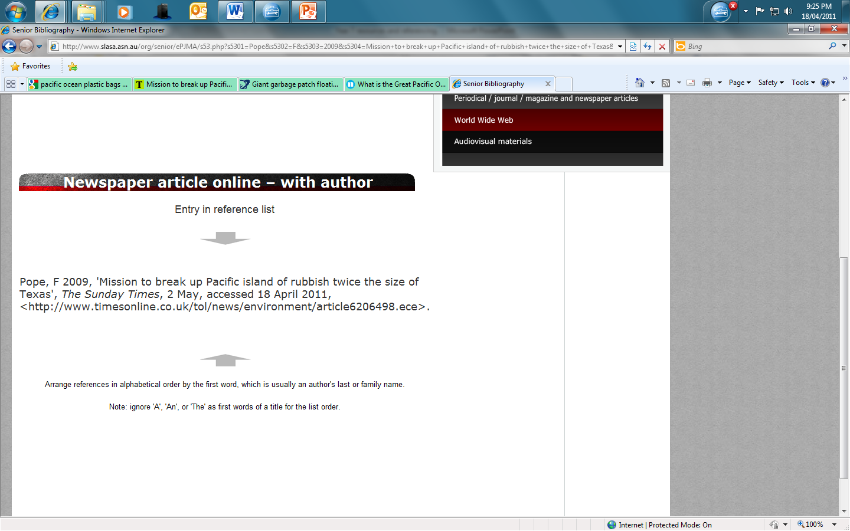

Slide 10
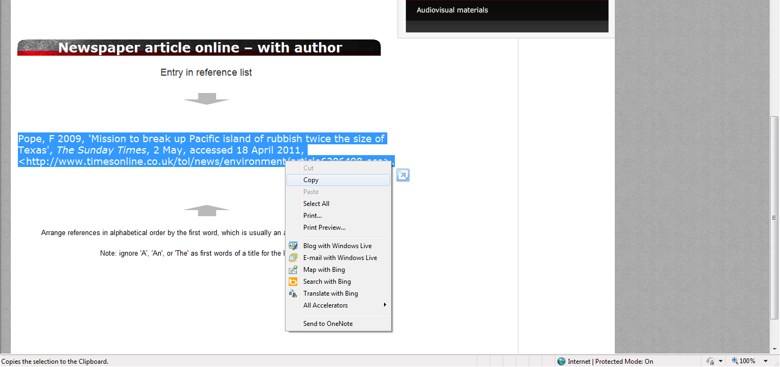

Slide 11
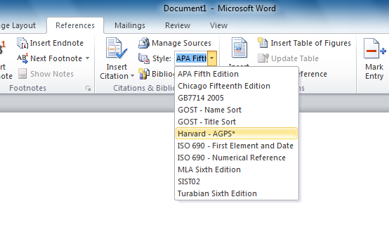
Referencing through Microsoft Word

Slide 12
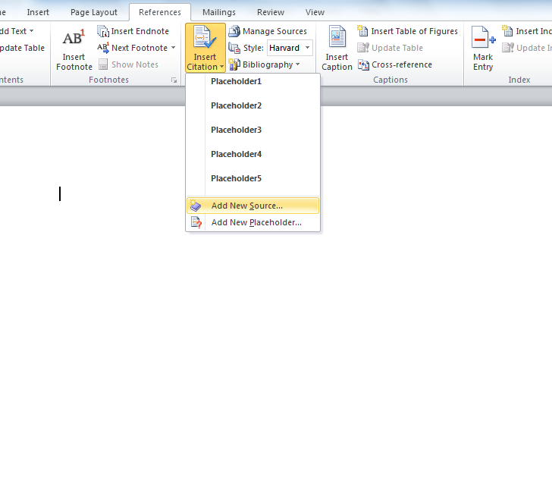

Slide 13
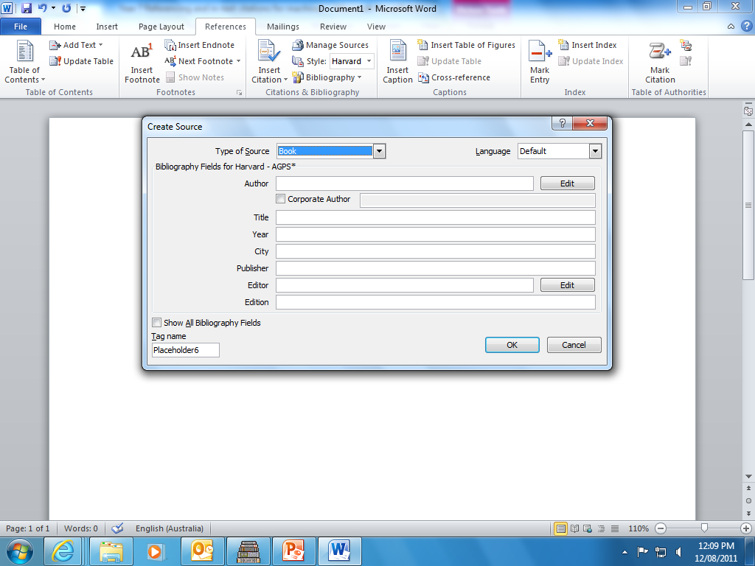

Slide 14
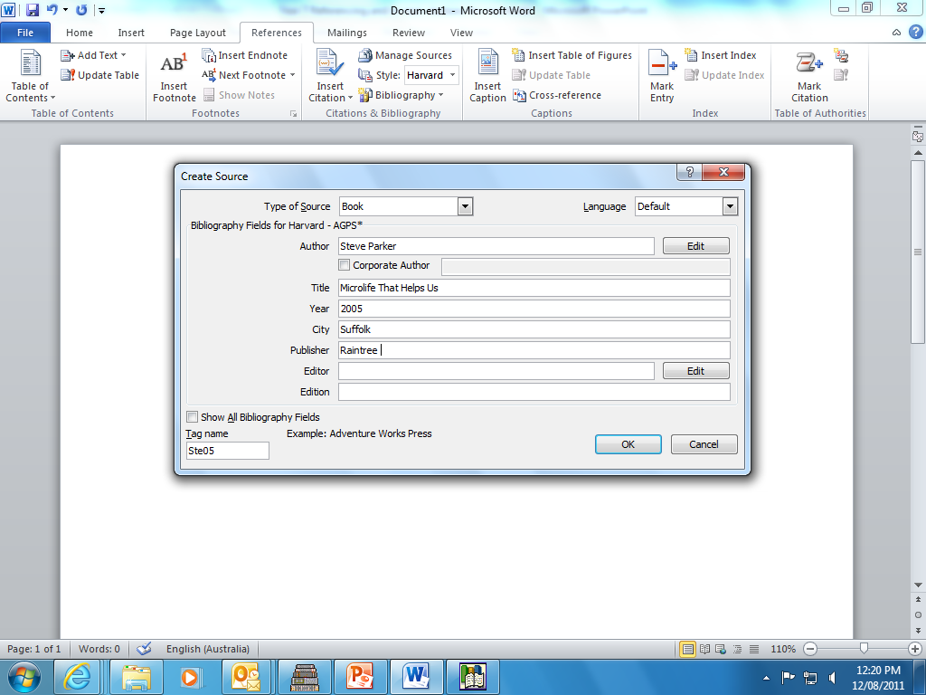

Slide 15
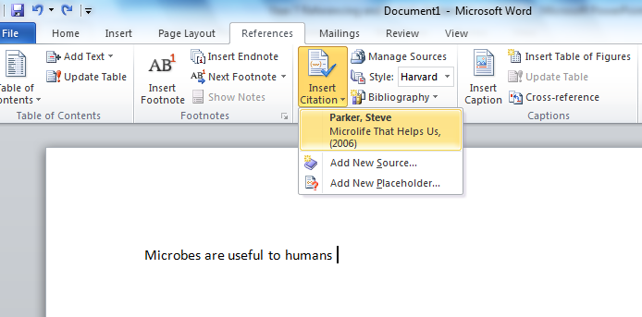
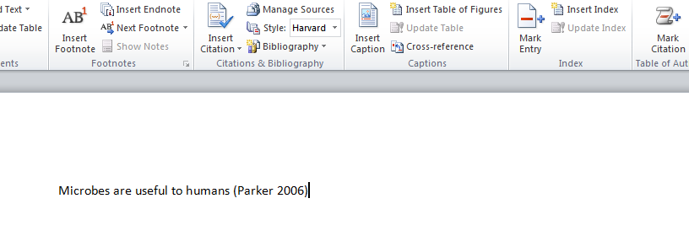

Slide 16
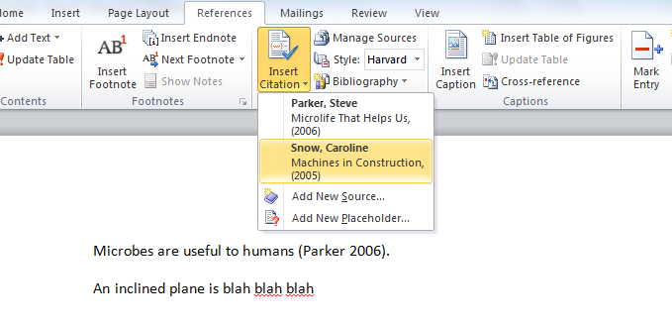
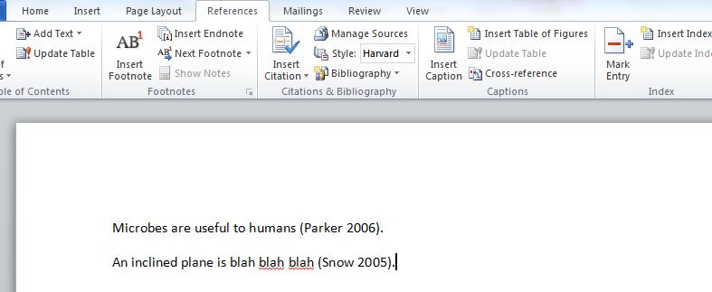

Slide 17
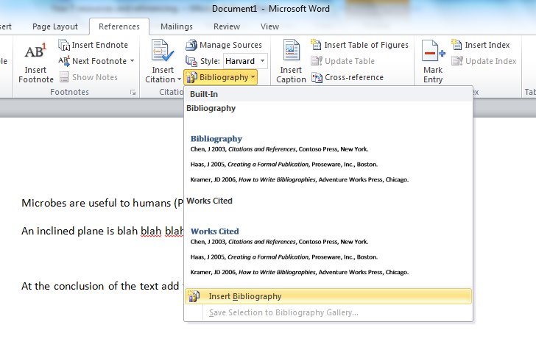

Slide 18
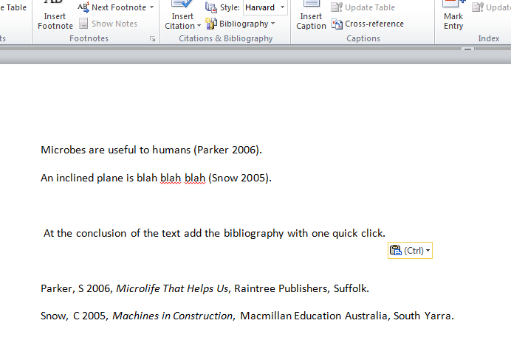

Slide 19
Bibliography
McLendon, R 2010. ‘What is the Great Pacific Ocean Garbage Patch?’ Mother Nature Network, viewed 18 April 2011, http://www.mnn.com/earth-matters/translating-uncle-sam/stories/what-is-the-great-pacific-ocean-garbage-patch
Pope, F 2009, 'Mission to break up Pacific island of rubbish twice the size of Texas', The Sunday Times, 2 May, accessed 18 April 2011, http://www.timesonline.co.uk/tol/news/environment/article6206498.ece
Walker, J 2003, Oil Spills, Franklin Watts, London.

