Slide 1
Resources for English Assignment
Search St Andrew’s Catalogue

Slide 2
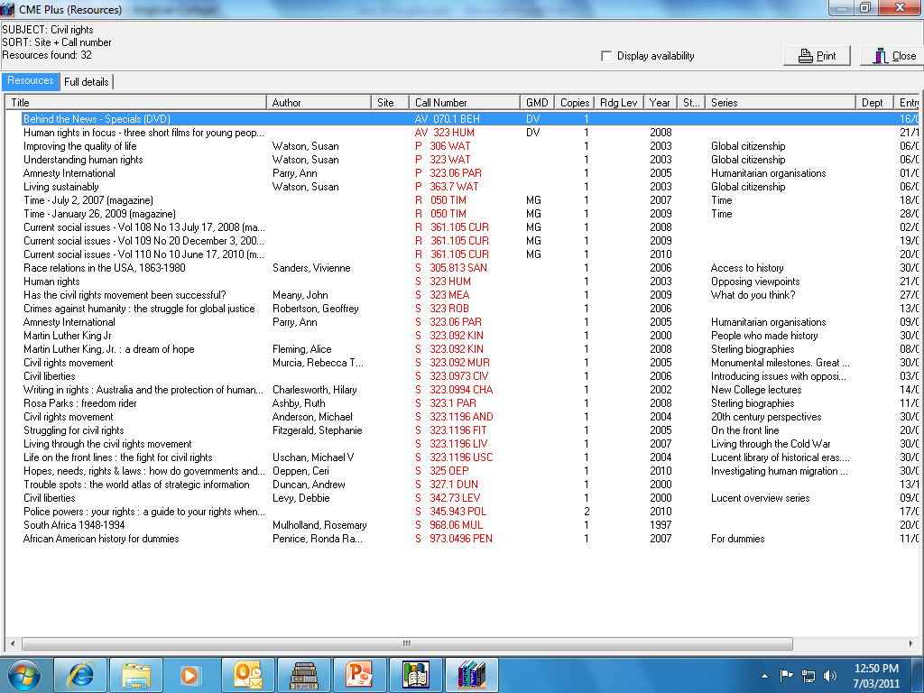

Slide 3
Resources for English Assignment
Search St Andrew’s Catalogue
Frozen Books – mainly Senior NF

Slide 5
Resources for English Assignment
Search St Andrew’s Catalogue
Frozen Books – mainly Senior NF
Time

Slide 6
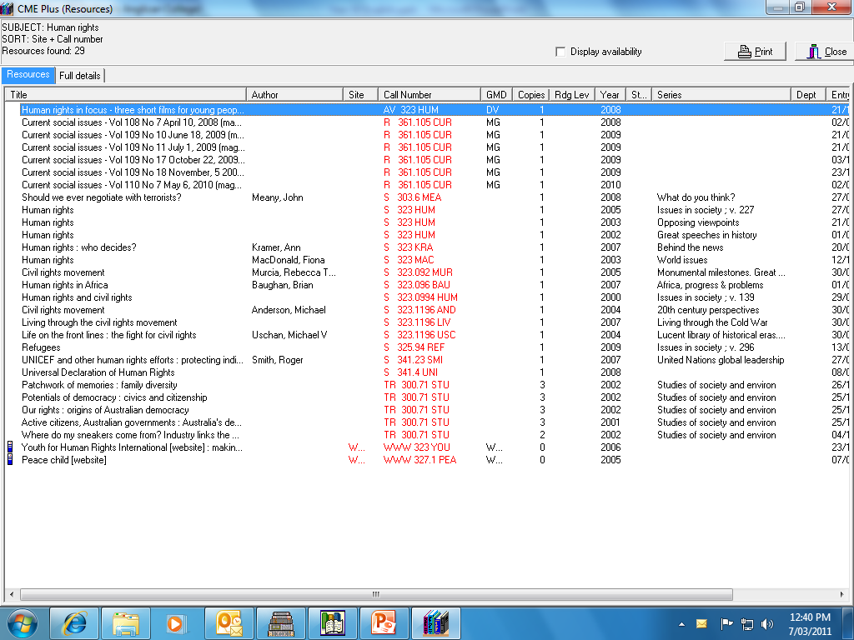

Slide 7
Resources for English Assignment
Search St Andrew’s Catalogue
Frozen Books – mainly Senior NF
Time
Current Social Issues

Slide 8


Slide 9
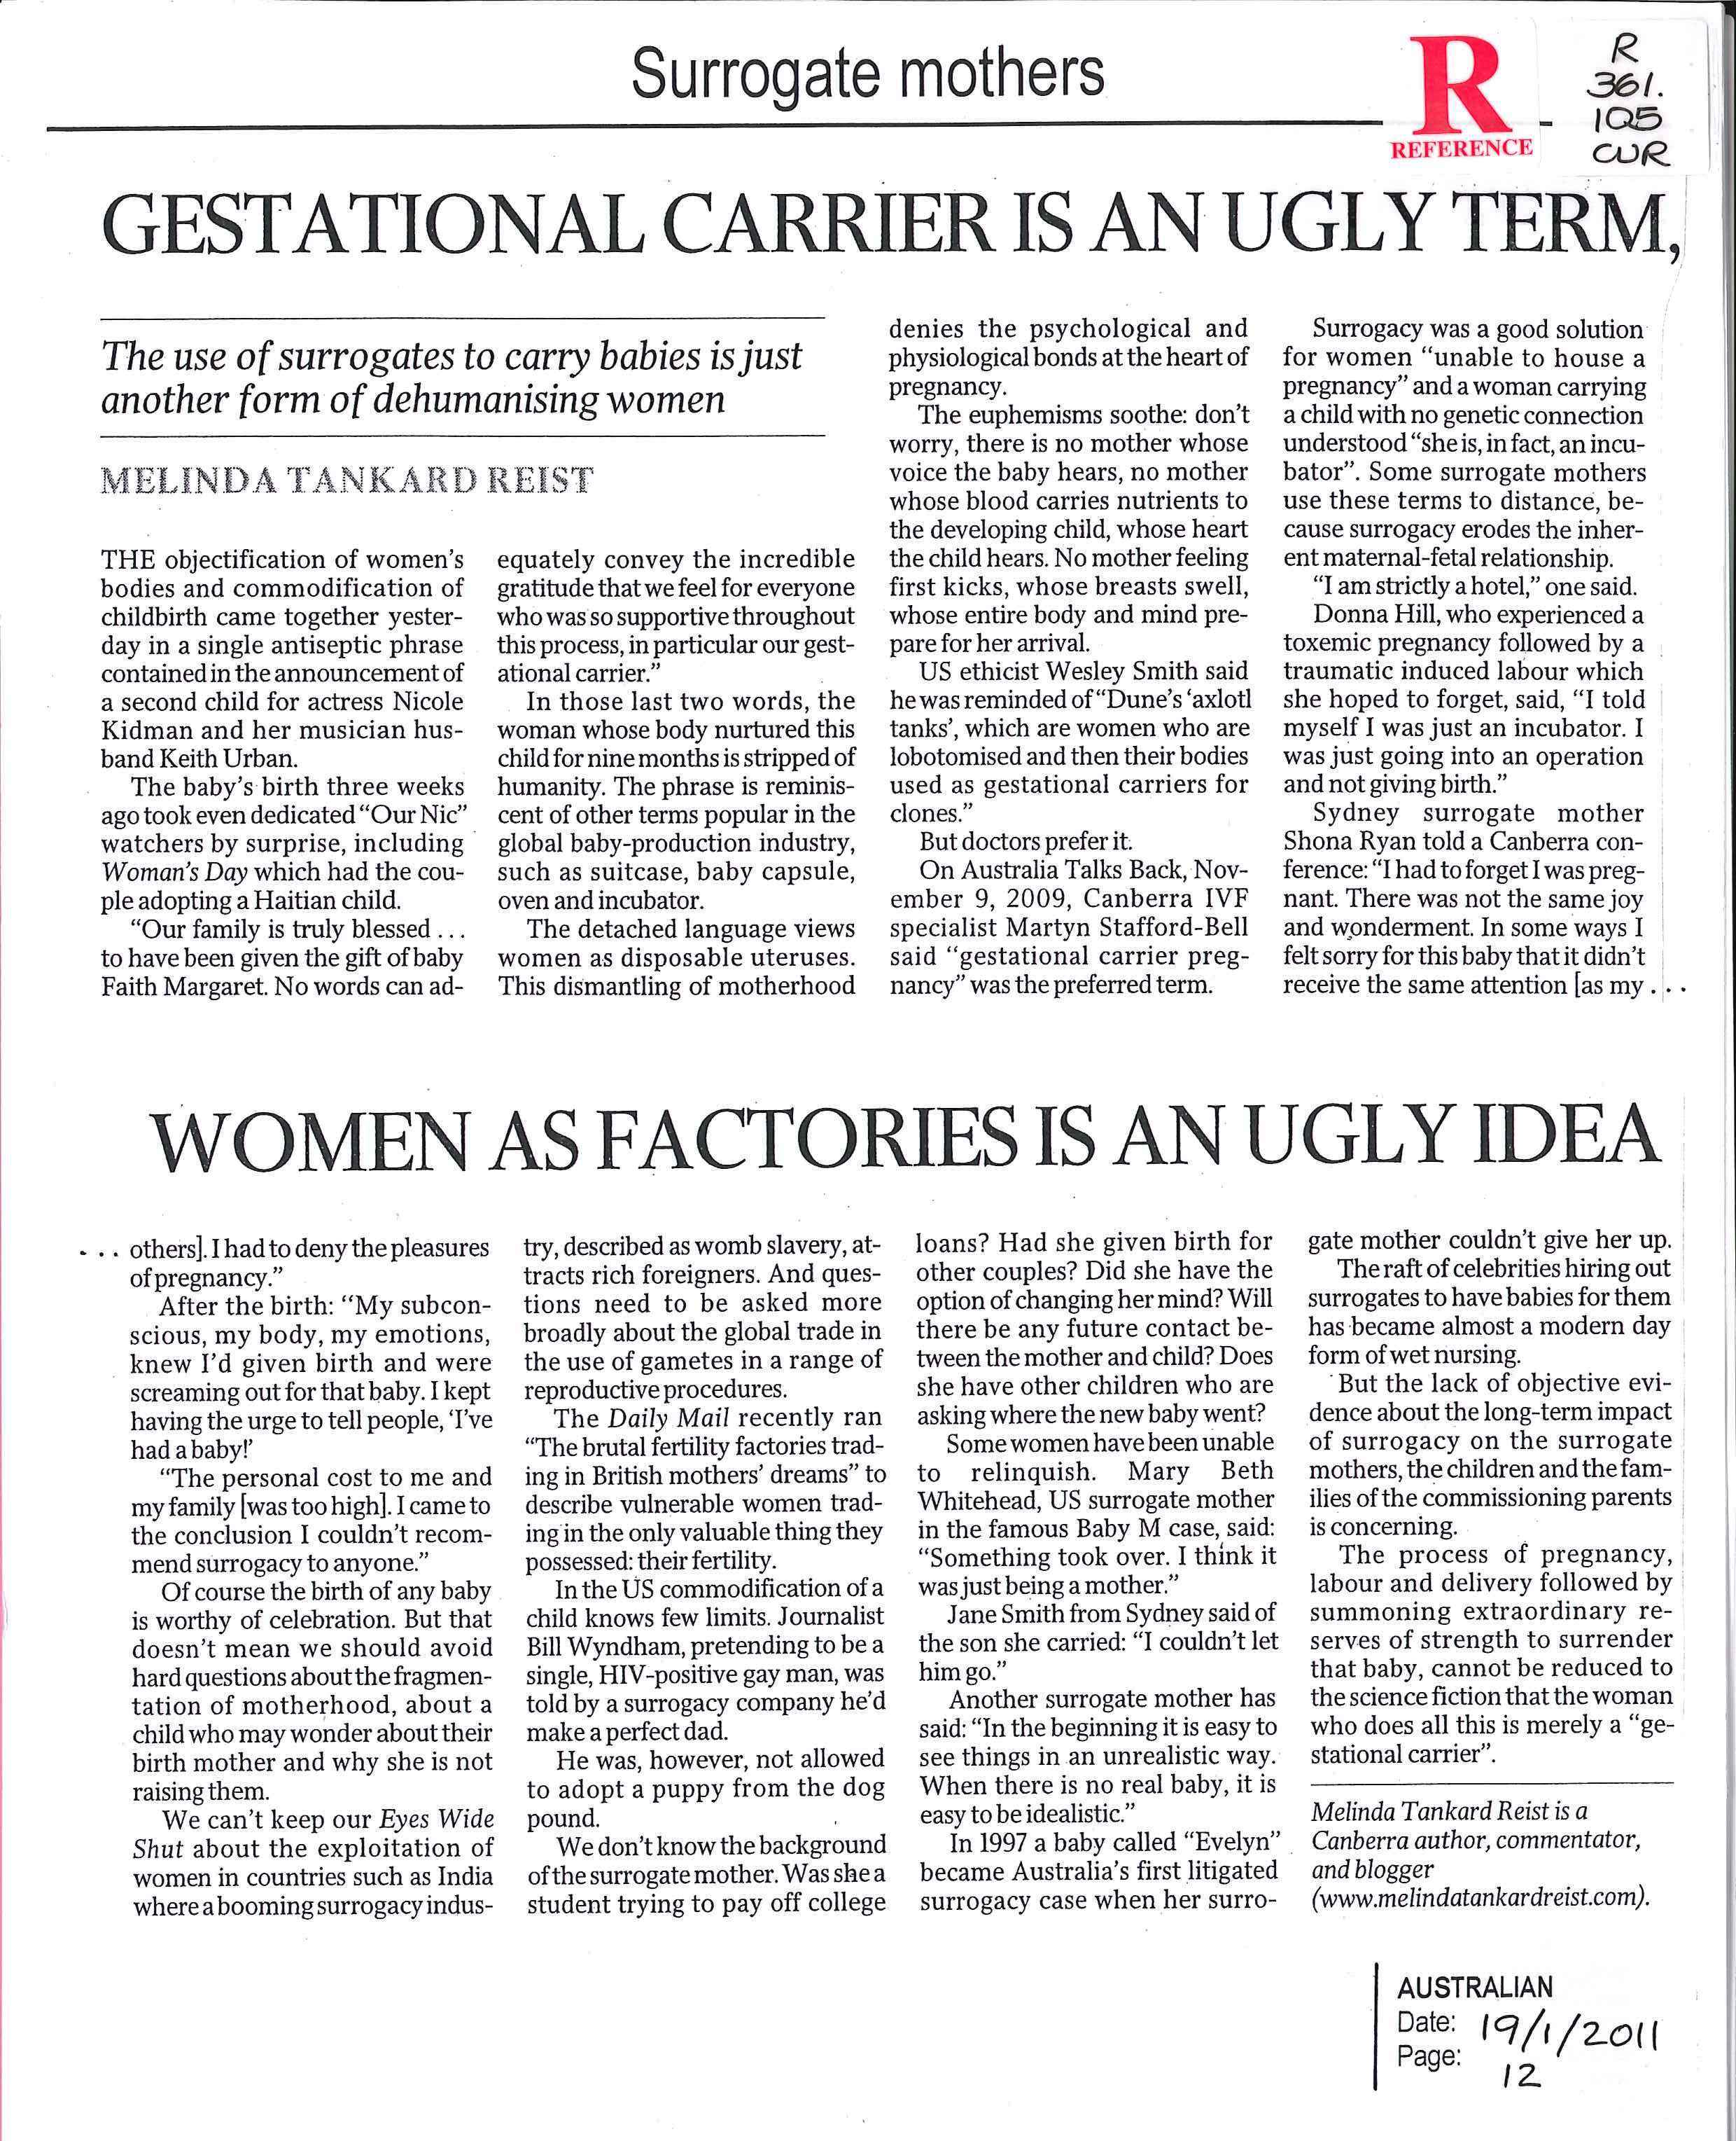

Slide 10
Resources for English Assignment
Search St Andrew’s Catalogue
Frozen Books – mainly Senior NF
Time
Current Social Issues
Current Environmental Issues – Green Cover

Slide 11
Important!!
You need your ID card for
Printing
Photocopying
Scanning
Borrowing

Slide 12
Databases
ANZRC & Expanded Academic
To navigate to databases
SAAC website
Learning for Life
Learning Centre

Slide 13
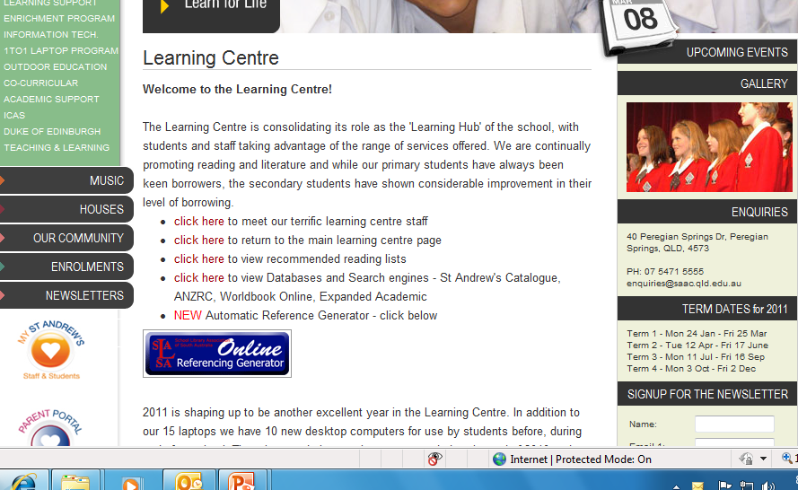

Slide 14
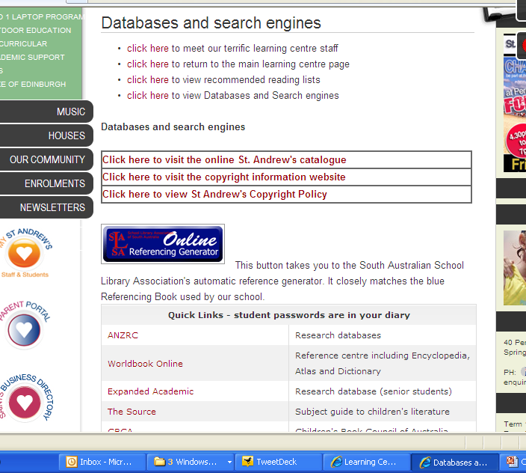

Slide 15
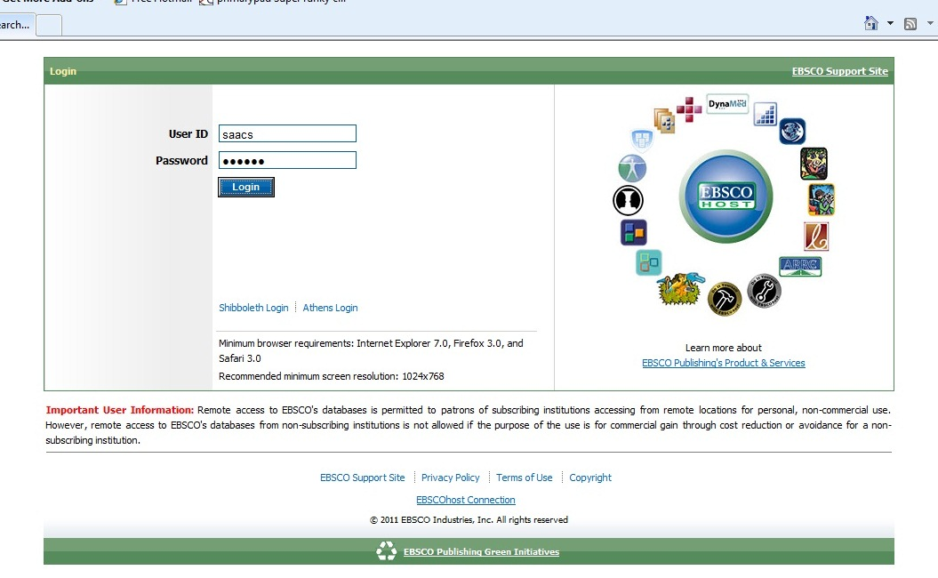
andrew
Passwords are
In your diary

Slide 16
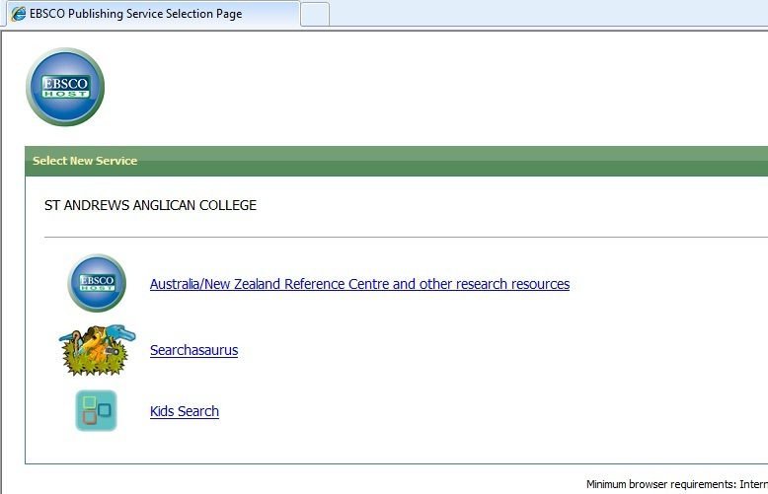

Slide 17
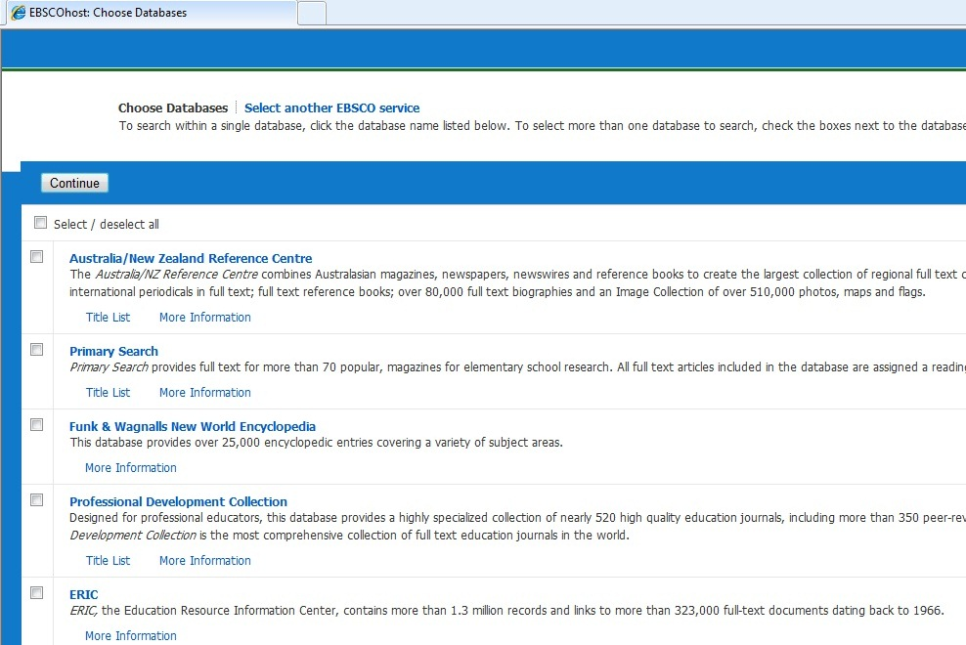

Slide 18
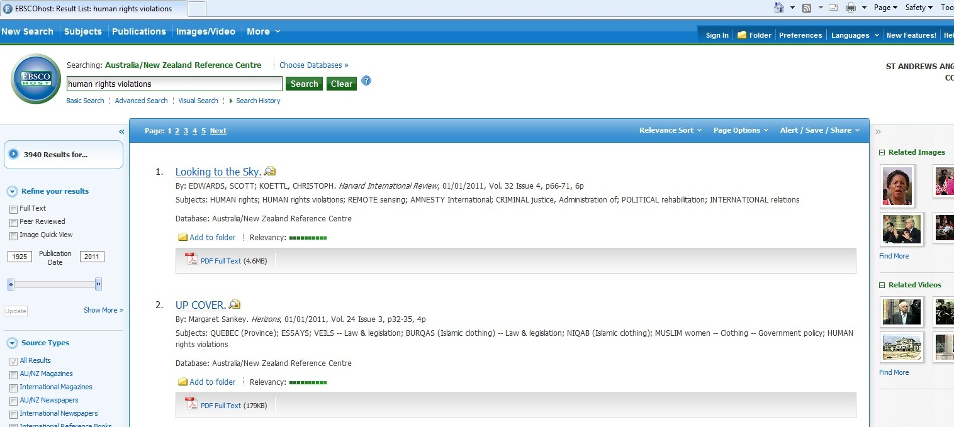

Slide 19
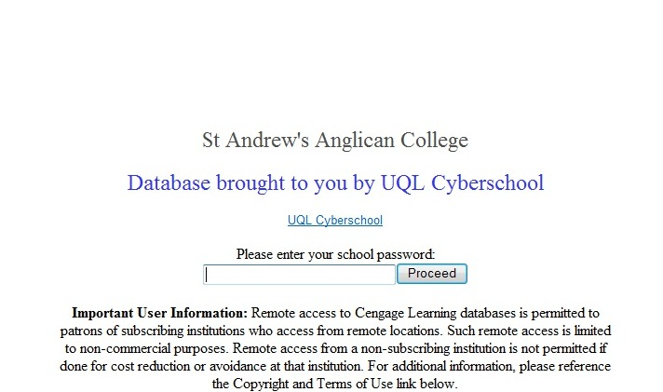
Expanded Academic
staac435

Slide 20
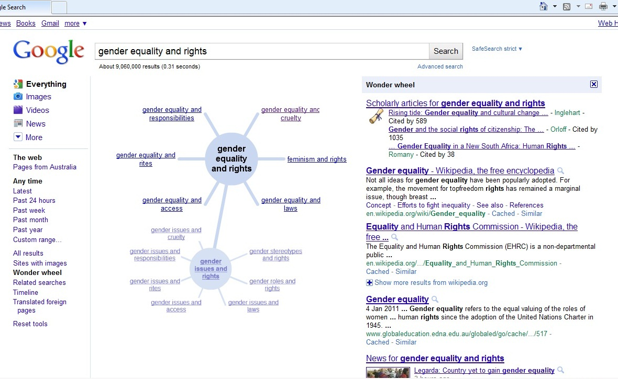

Slide 21
Our school uses …
Style of referencing
Harvard

Slide 22
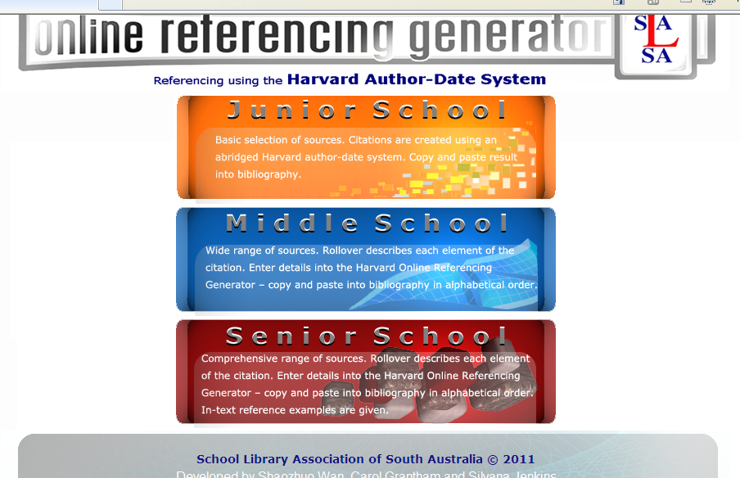

Slide 23
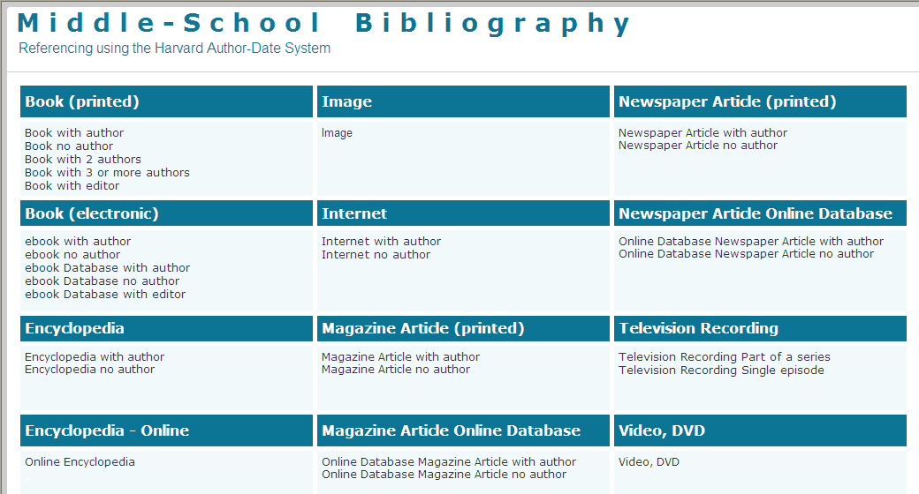

Slide 24
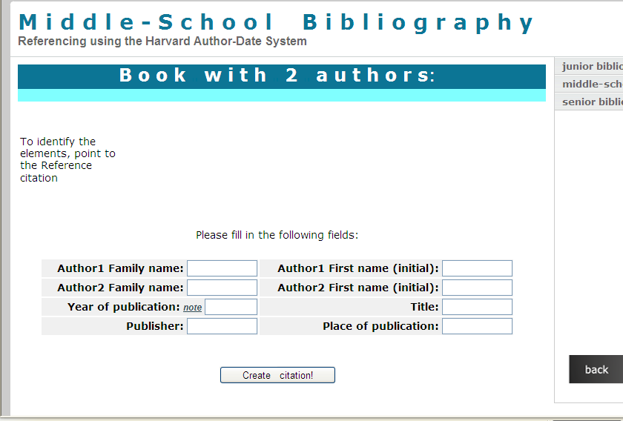

Slide 25
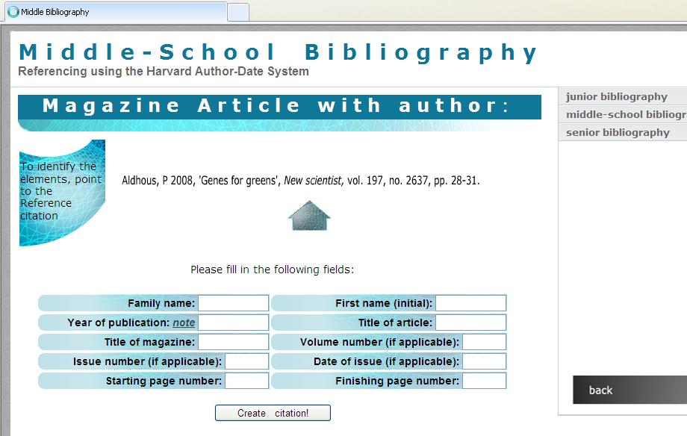

Slide 26
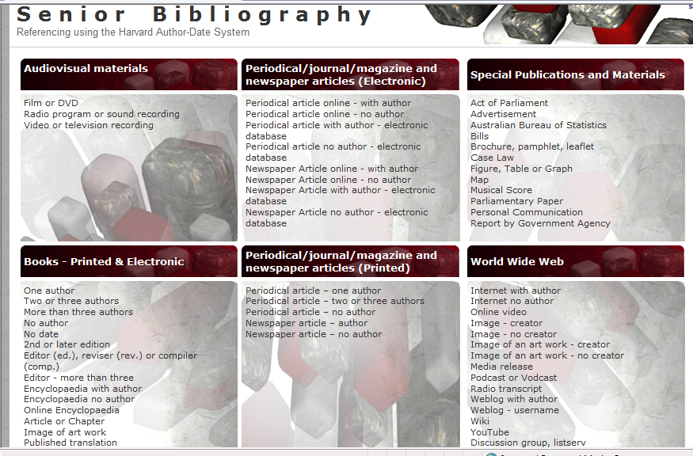

Slide 27
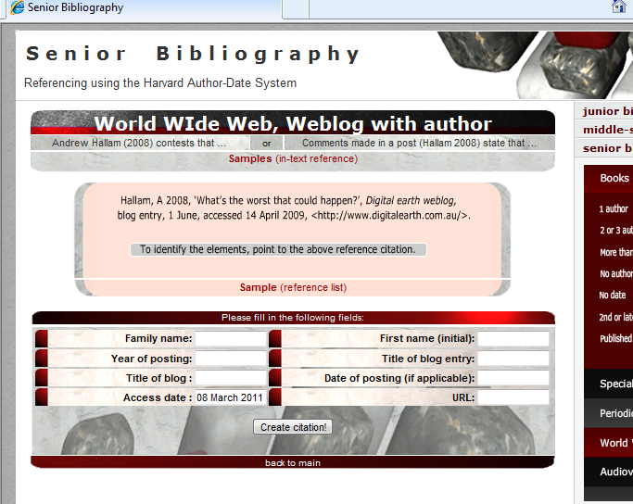

Slide 28
If you need help….
From 7.30am
Morning Teas and Lunchtimes
After school until 3.30 Tues and Friday
And 4.30 Monday, Wednesday and Thursday
Or email on csharp@saac.qld.edu.au

