Slide 1
Year 8 i-create
Roll call and notices
Introduction
Expectations
Video Clip
Criteria
Educational – explains a concept
Informative - new product or innovation
Entertaining – ICT related topic
Short – no more than 3 minutes
Introduction to subject

Slide 2
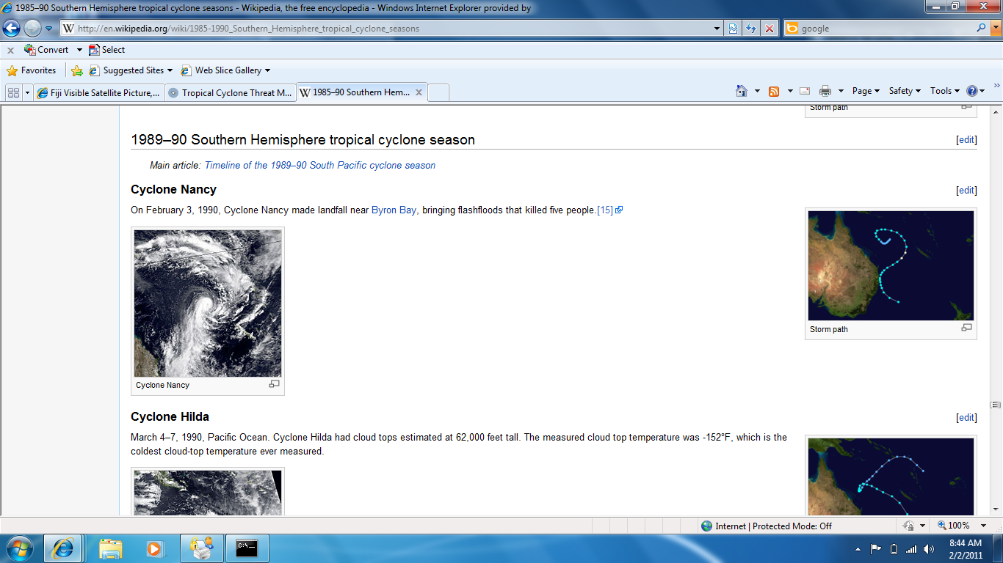

Slide 3
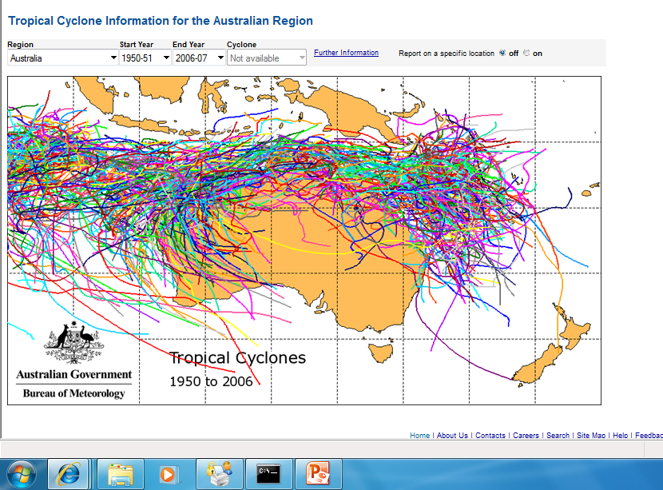

Slide 4
What is the purpose of ‘school’ and ‘education’?

Slide 5
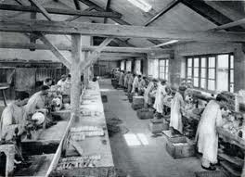
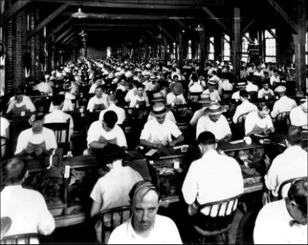
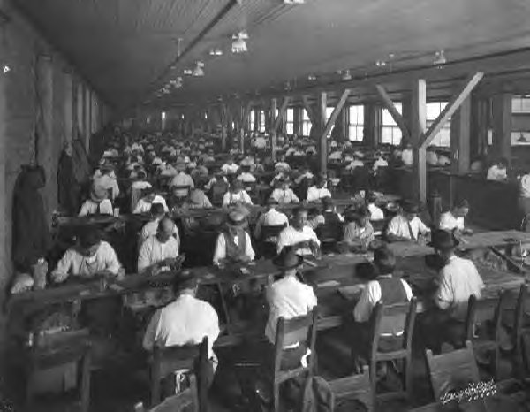
In the past…..

Slide 6
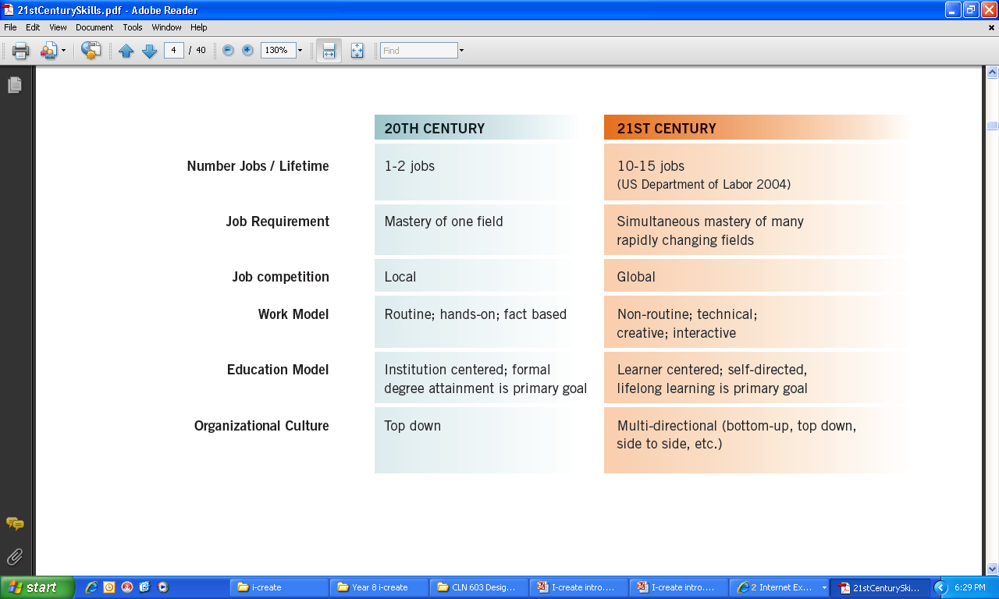

Slide 7
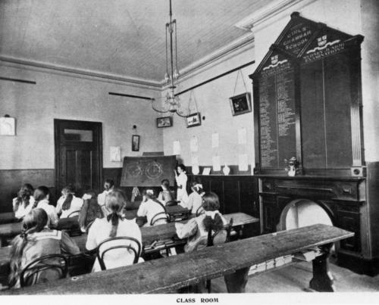
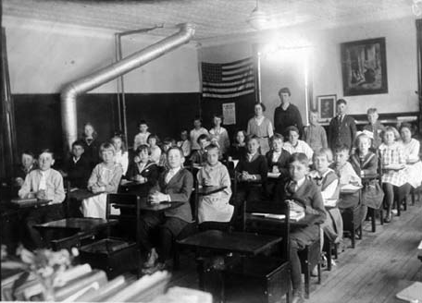
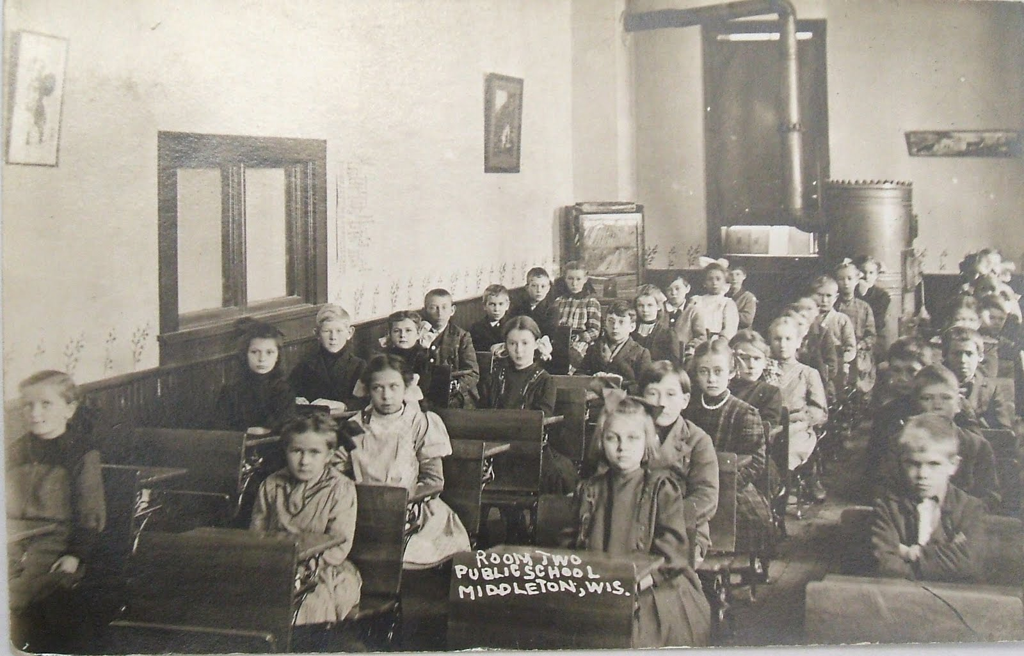

Slide 9
21st Century Workplace….
Google clip
Changes in schooling and education

Slide 10
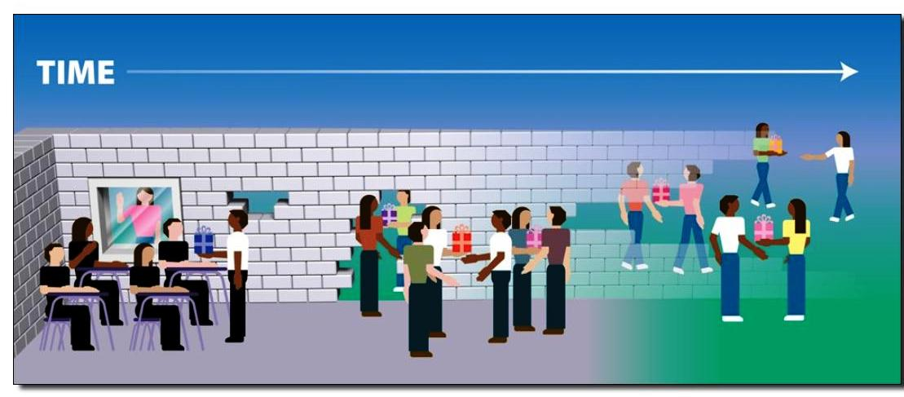
‘Knocking down the walls’
(Alec Couros, 2008)

Slide 11



The unconnected classroom / learner
during school time
occasional expert visits
school
community
occasional class excursions
teachers
school library
(Carr, O’Neill; 2006)
snail mail
mobiles, phones, fax machines, TV, video
Notes:
11

Slide 12
The connected learner
any where ~ any time ~ in time
Primary sources
Secondary sources
learning objects
writers
world libraries and museums
learning communities
original artefacts and documents
people’s experience
online learning
experts
websites
digital repositories
collective thinking
organisations
Unis/Colleges
all teachers
any school
RSS feeds
speakers
peers
collaborative projects
original works
common interest groups
networks
original photos,
images, video, audio
world news
action learning groups
global groups
commercial companies
world events
(Carr, O’Neill; 2006)
chat forum wikis blogs LMS CMS podcast data/tele/video conferencing messaging email & listservs video cast/streaming webcasts meeting tools web authoring
mobiles, phones, VOIP, PDAs, tablets, desktop, laptop, future technologies
Notes:
12

Slide 13
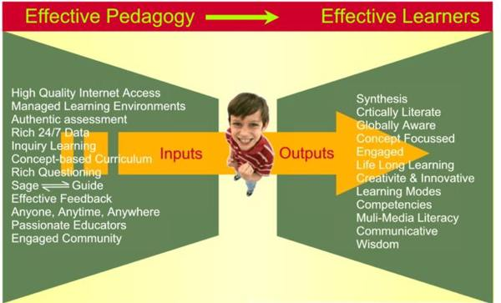
What are the competences, skills, attitudes, capabilities and dispositions students will requires in order to enjoy and manage their complex 21st century lives?
(Treadwell, 2008)

Slide 14
21st Century Skills Framework – Adapted for Libraries and Museums
LEARNING AND INNOVATION SKILLS
• Critical Thinking and Problem Solving
• Creativity and Innovation
• Communication and Collaboration
• Visual Literacy
• Scientific and Numerical Literacy
• Cross-Disciplinary Thinking
• Basic Literacy

Slide 15
INFORMATION, MEDIA, AND TECHNOLOGY SKILLS
• Information Literacy
• Media Literacy
• Information, Communications and Technology (ICT) Literacy

Slide 16
LIFE AND CAREER SKILLS
• Flexibility and Adaptability
• Initiative and Self-Direction
• Social and Cross-Cultural Skills
• Productivity and Accountability
• Leadership and Responsibility

Slide 17
21ST CENTURY THEMES
• Global Awareness
• Financial, Economic, Business, and Entrepreneurial Literacy
• Civic Literacy
• Health Literacy
• Environmental Literacy

Slide 18
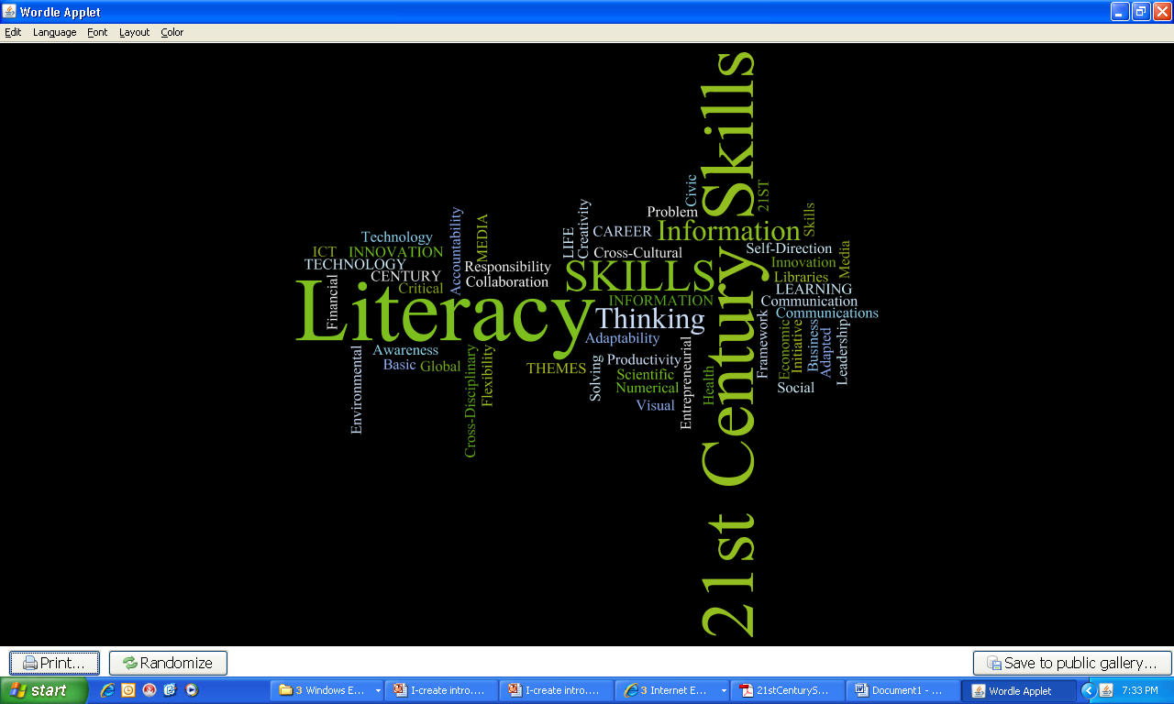

Slide 19
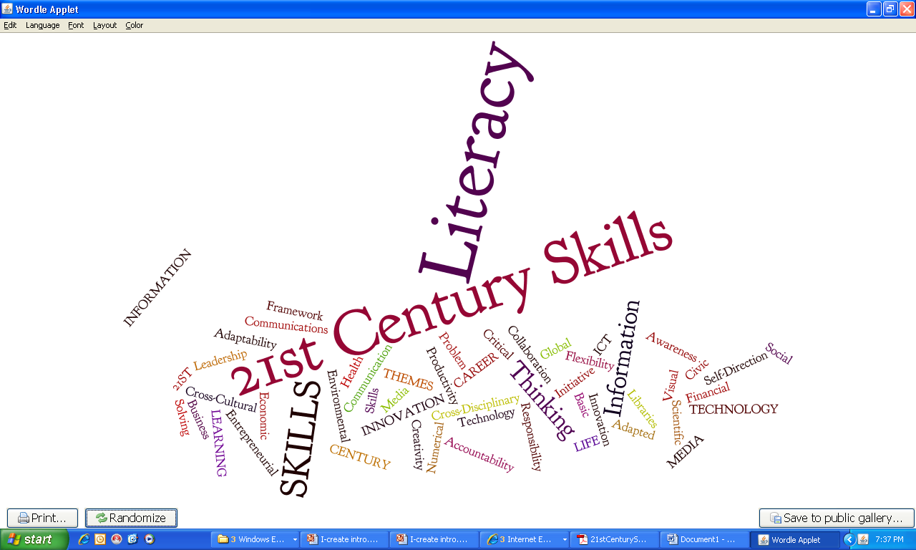

Slide 20
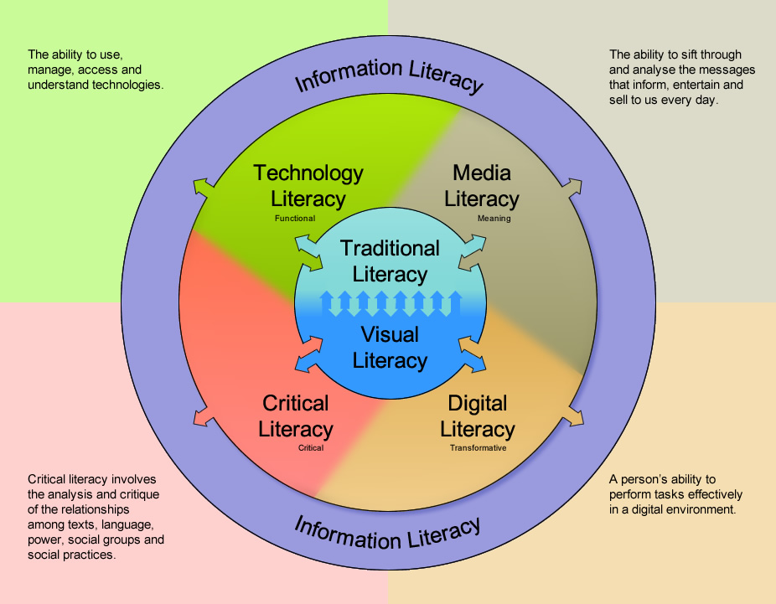
Mark staines slide
Draft image supplied by Mark Staines, Library Services, Education Queensland.

Slide 21
Visual Literacy & digital literacy
graphic organisers
digital storytelling
Web 2.0 tools
blogging – to showcase and reflect on our learning
animation
social networking, cyber etiquette & safety
….. and more.

Slide 22
Other areas we will cover…
Study skills & study planner
Goal setting
Using the library
Effective internet searching
Use of databases
Referencing and automatic reference generators

Slide 23
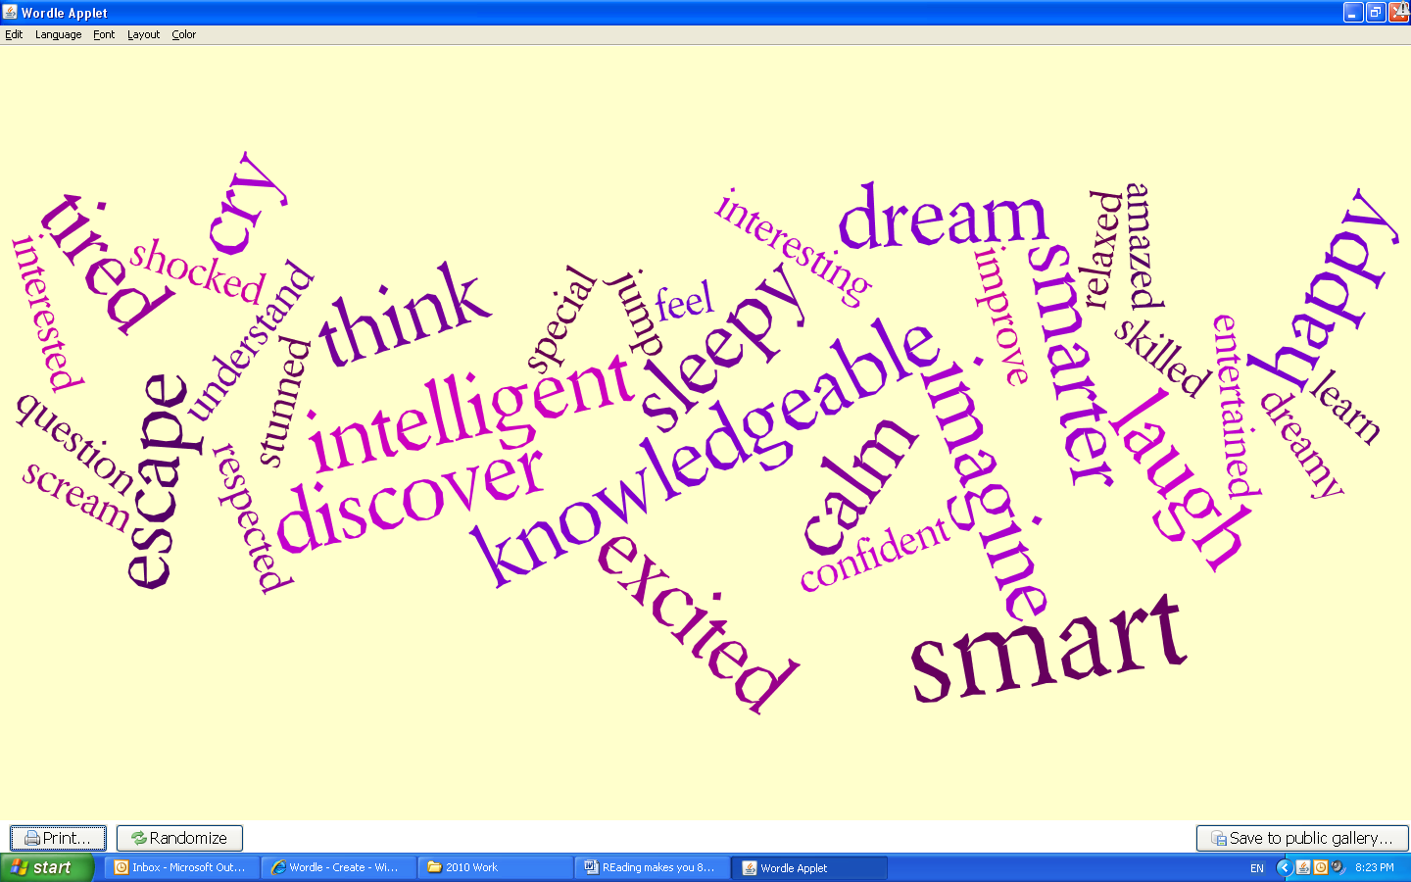
Developing and improving literacy skills…..
Reading makes you…

Slide 24
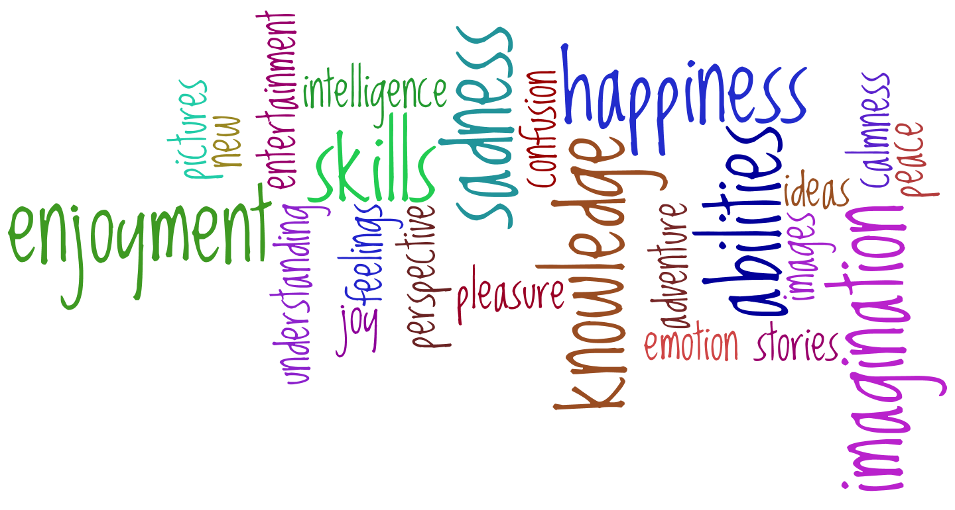
Reading brings you….

Slide 25
Homework for next week
Arrange a display folder, document wallet or book
Keep your eye peeled for video clips, cartoons etc to email to Mrs. Sharp
csharp@saac.qld.edu.au
Getting to know a little about you…..
Video clip…..
Borrowing
Return to desks & pack up before dismissal

