Slide 1
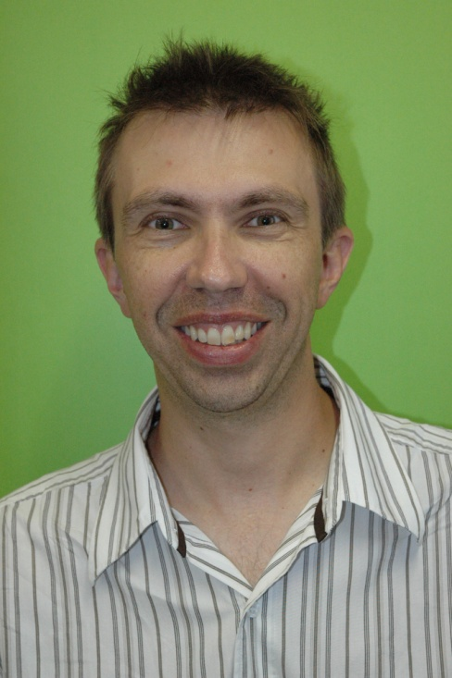
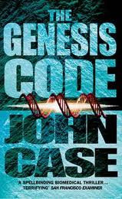
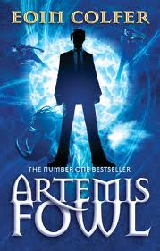
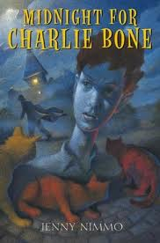
Unfortunately at high school the English Dept suppressed my free reading. We were expected to read from a list of books and this went towards our marks. We had to write reports on each book we read.
After university I was able to get into reading titles I chose myself and at my own pace – not in a rush for assessment.
Two authors I enjoyed were Raymond Feist and Stephen King.
I enjoy medical thrillers and titles such as The Genesis Code by John Case. The Da Vinci Code seemed like a poor quality copy of this original story.
At the moment I’m reading Artemis Fowl and Charlie Bone.
Stuart Koy

Slide 2
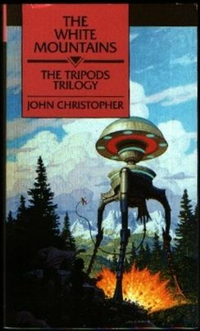
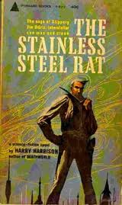
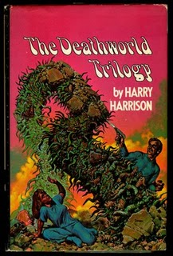
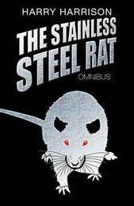
I read a series or trilogy called Tripods when I was about 13.
I enjoy science fiction and fantasy adventure.
Harry Harrison is one of my favourites, he’s clever, funny sci fi author. I think the title ‘Stainless Steel Rat’ is a great one.
Death World trilogy is another favourite of mine.
Dave Rudkin

Slide 3
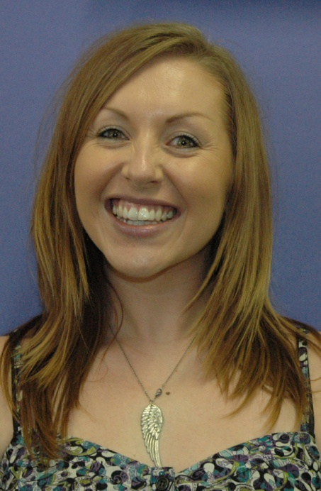
Okay - thinking back to my childhood/teenage years...
I really got switched onto reading through (very sadly) The Babysitter's Club selection of novels and the massive series that it became. I had a friend and we always bought one new each and then swapped them over after we have devoured the literally world within. (Well, the literary world of girls babysitting and dealing with runaway kittens and cute boys next door)
I also really got hooked through Archie comics, which infuriated my dad as he said they were American in their spelling, as I always fought with the 'At least I'm reading' comment. Haha - oh, the money wasted there!
Lately my literature preferences are all about escapism and reading for pleasure when I have the chance. Constantly reading Drama texts and or plays during the term means that I thoroughly enjoy reading 'chic literature' style novels where said woman departs cheating boyfriend for a holiday abroad and ends up meeting man of her dreams - etc!
Tara Mackie

Slide 4
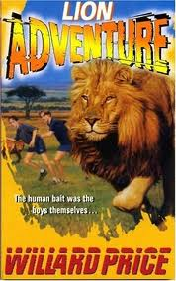
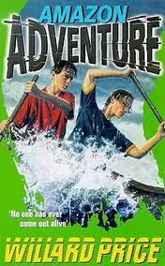
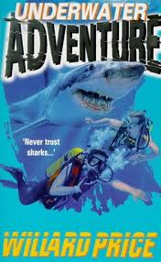
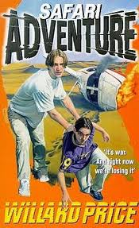
When I was 5 I read ‘The Adventures of Digit Dick on the Great Barrier Reef’ and this actually lead to me doing Marine Biology and Chemistry at Uni plus piqued my future conscience re Environmental awareness.
When I was 10 I was reading the adventure books/series by Willard Price…..awesome.
Brad Bowen
Head of Secondary

Slide 5
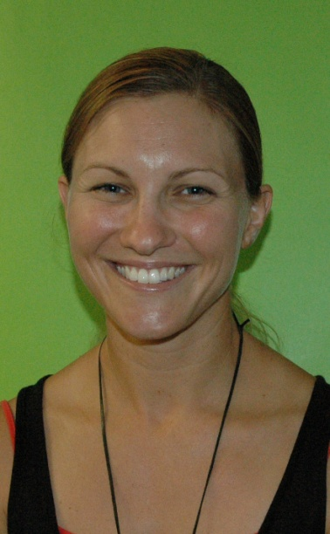
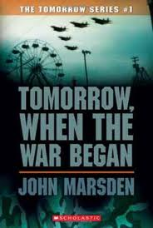
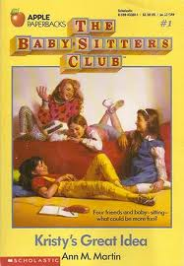
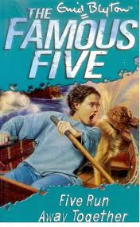
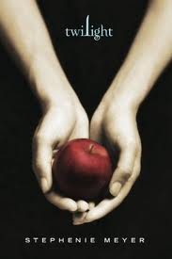
I used to love the ‘Tomorrow When the War began’ series by John Marsden. In fact I loved all John Marsden books when I was a teenager. I remember not being able to put these books down! I also loved ‘The Babysitters Club’ and ‘The Famous Five’ when I was very young! I was hooked on the Twilight series just recently!
Lisa Crowther

Slide 6
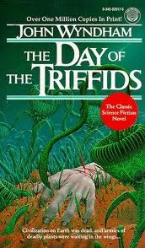
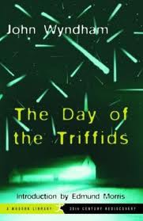
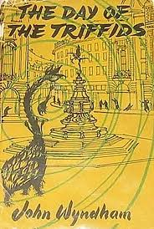
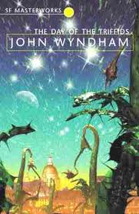
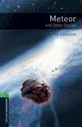
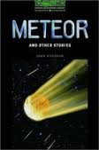
I have to confess to having had a moment when I was about 13 or 14, and I read "The Day of the Triffids" by John Wyndham. I imagined what it would be like to be one of the lucky survivors with my sight, and having access to all the world's resources. Another of his short stories, "Meteor" is one that stuck with me also.
Hope this helps.
Andy O’Neill

Slide 7
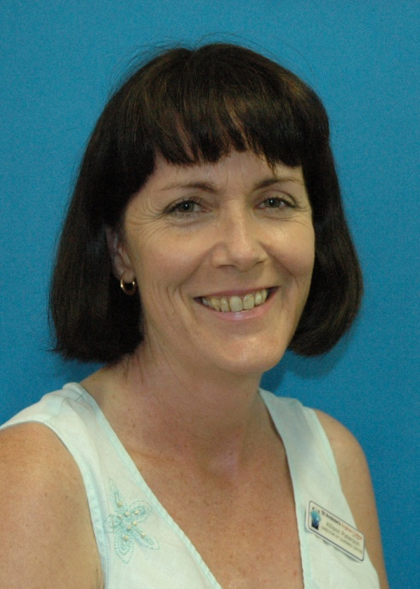
Once upon a time… okay, skip that and get to the serious bit. As a Primary student I recall a very dark and cold public library but within was a very warm and fuzzy librarian. It was there I found the whole Little House on the Prairie series. I loved those and from then historical fiction was all I read. I progressed from opening the Wild West to the grandeur of James Michener’s novels, epic historical sagas of generations and places. I learned loads about the world without setting a foot outside the little country town I lived in. From historical fiction I moved on to all sorts of genres, broadened my horizons and now even enjoy fantasy. Give other genres a go, a great story is always a great story!
Allison Paterson

Slide 8
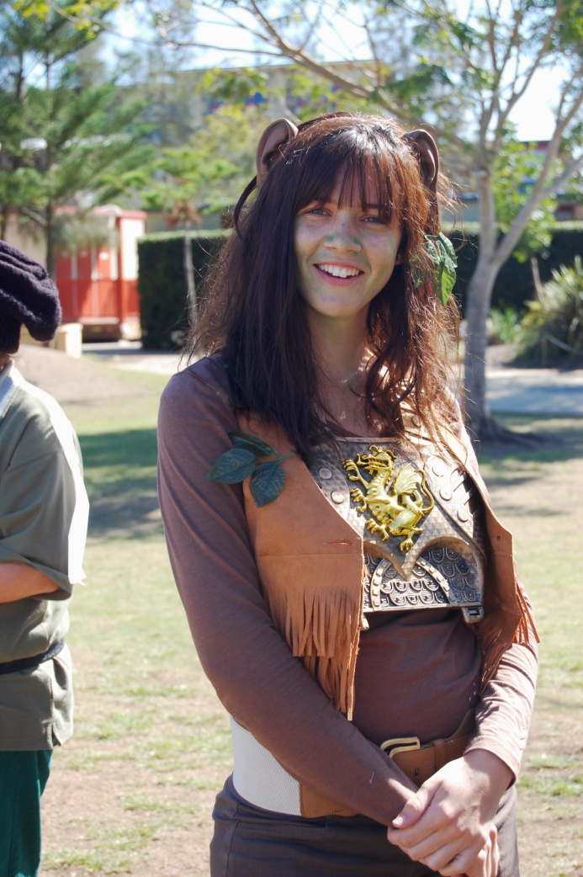
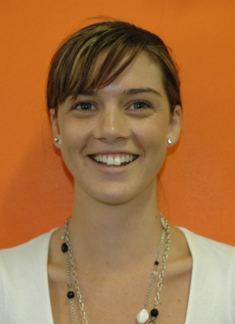
I got hooked on reading when I was about 8 or 9 and was an avid fan of The Babysitters Club – I had every book in the series and would get them for birthdays, Christmas etc, once I had finished the series, a few times, I moved on to Sweet Valley High and would go to the mobile Library every Tuesday to swap over my Sweet Valley High books until I had read all versions of Sweet Valley.
In Year 12 I read Angela’s Ashes by John McCourt and then through University and since, biographies became my favourite and now the problem is just finding time.
Amy Nieuwenhuis

Slide 9
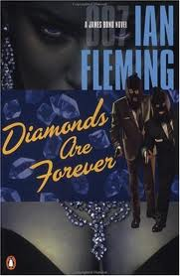
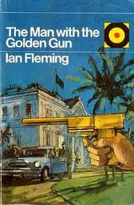
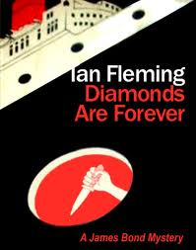
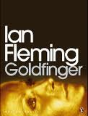
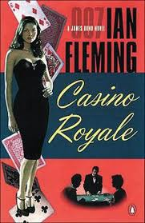
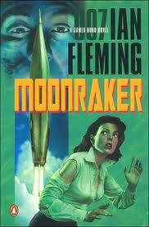
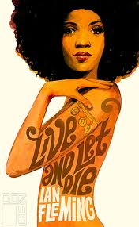
I’m embarrassed to admit it but I was into the James Bond series by Ian Fleming.
Ron Bartholomew

